Slide 1
SOLOVAY-KITAEV THEOREM
Ramaiah Institute of Technology
(Autonomous Institute, Affiliated to VTU)
Department of Computer Science and Engineering
M. Tech (CSE) – II Semester (Term: Jun-Sep 2022) Non CIE Component
Quantum Computing(MCS22)
Presented By:
JEEVITHA J
1MS21SCS09

Slide 2
INTRODUCTION
The Solovay-Kitaev (SK) theorem is one of the most important fundamental results in the theory of quantum computation.
The SK theorem is important if one wishes to apply a wide variety of different single-qubit gates during a quantum algorithm, but is restricted to use gates from a more limited repertoire.
Such a situation arises naturally in the context of fault-tolerant quantum computation.
In this situation one must use the limited set of fault-tolerant gates to build up accurate fault-tolerant approximations to all the gates used in the algorithm, preferably in the most efficient manner possible.
The SK theorem tells us that such efficient constructions are possible.

Slide 3
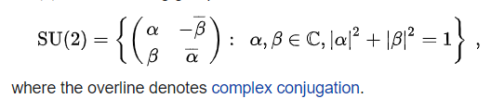
SU(2) Group:
SU(2) is the set of all 2 x 2 single qubit unitary matrices with determinant equal to one. It is given as:

Slide 4

Solovay – Kitaev Theorem
Statement: Let G be a finite set of elements in SU(2) containing it’s own inverses and such that the group <G> they generate is dense in SU(2).
Consider some Then there is constant c such that for any there is a sequence S of gates from G of length such that

Slide 5
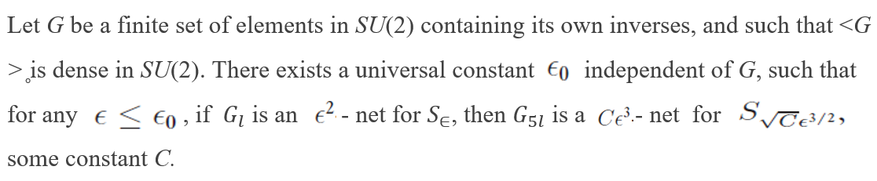
Proof:
Lemma:

Slide 6
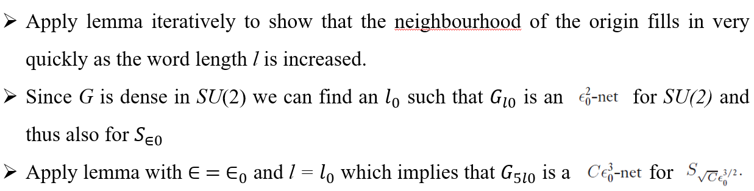
Step 1:

Slide 7
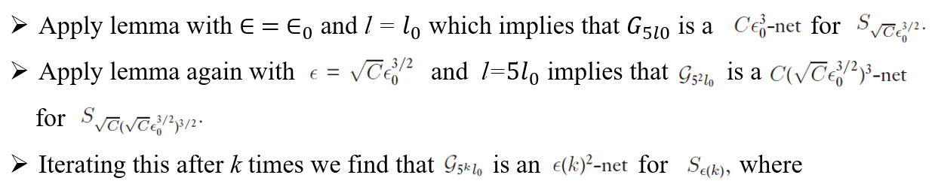

(1)

Slide 8
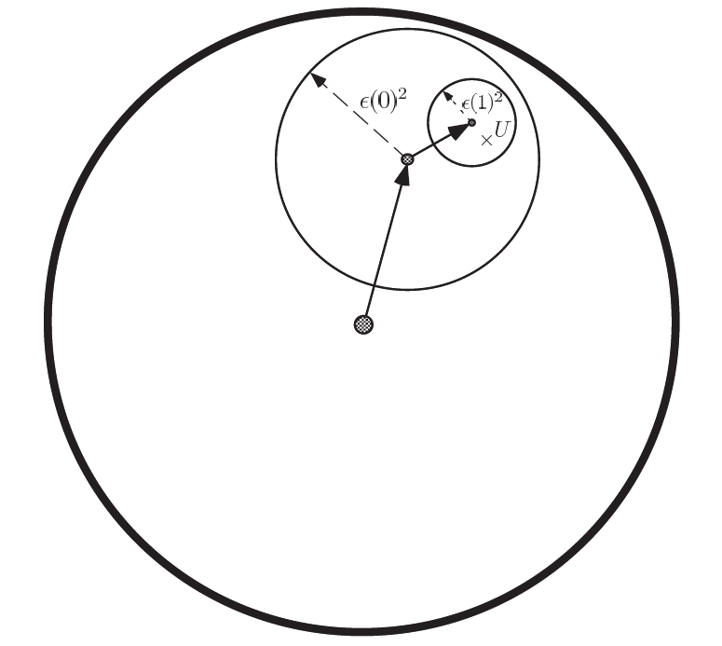
Step 2:
Let U be any element of SU(2) and use the translation idea approximate U using products of elements of G.
Fig: Transalation step

Slide 9




To approximate to some desired accuracy, we therefore must choose k such that
(2)
Substituting (1) in (2) can be restated as:
It follows that the number of gates required to approximate to within $∈$ satisfies
That is, the number of gates required to approximate to within $∈$ is

Slide 10
Q & A
Q. What does Solovay–Kitaev theorem suggest for Approximating Unitary Transformations
A:- Solovay-Kitaev theorem guarantees the existence of approximations to arbitrary unitaries with elements from universal gate sets that converge relatively quickly and corresponds to a simple algorithm, that does not mean that the problem of approximation is anywhere close to settled. The goal of this work is to use the Solovay-Kitaev algorithm in conjunction with several popular universal gate sets to experimentally test efficiency at low tolerance and short sequences, considering each gate used to have equal cost.

Slide 11

Single Qubit Quantum Gates
The states are represented as
Where θ and ϕ are real numbers

Slide 12
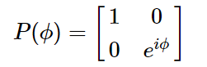
P-Gate
The P-gate (phase gate) is parametrised, that is, it needs a number (ϕ) to tell it exactly what to do. The P-gate performs a rotation of ϕ around the Z-axis direction. It has the matrix form:
Where ϕ is a real number.

Slide 13
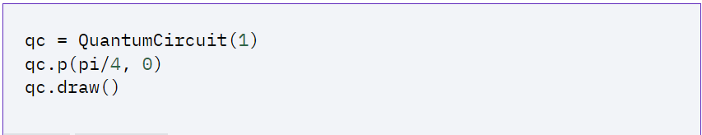
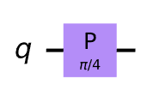
the Z-gate is a special case of the P-gate, with ϕ=π

Slide 14

I-Gate
It is called as Identity gate. It is simply a gate that does nothing. Its matrix is the identity matrix:
Applying the identity gate anywhere in your circuit should have no effect on the qubit state. There are two main reasons
one is that it is often used in calculations
it is often useful when considering real hardware to specify a ‘do-nothing’ or ‘none’ operation.

Slide 15
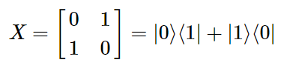
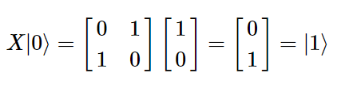
X-Gate
The X-gate is represented by the Pauli-X matrix:
To see the effect a gate has on a qubit, we simply multiply the qubit’s statevector by the gate. We can see that the X-gate switches the amplitudes of the states |0⟩|0⟩ and |1⟩|1⟩:

Slide 16
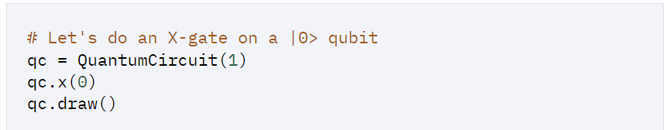
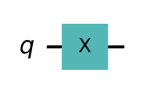

Slide 17
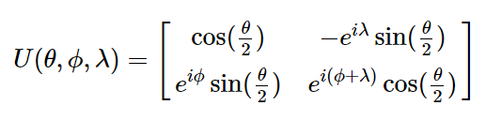
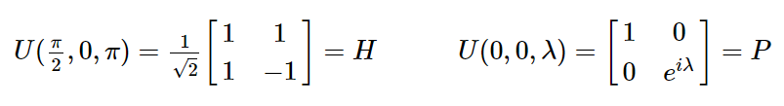
U-Gate
The U-gate is the most general of all single-qubit quantum gates. It is parametrized as
In some specific cases of the U-gate in which it is equivalent to the H-gate and P-gate respectively.

Slide 18
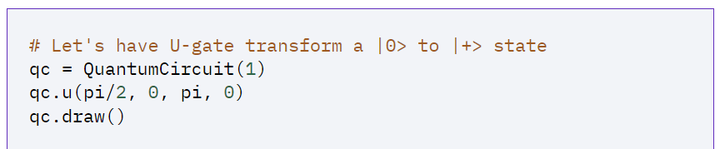
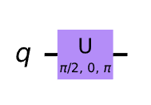

Slide 19
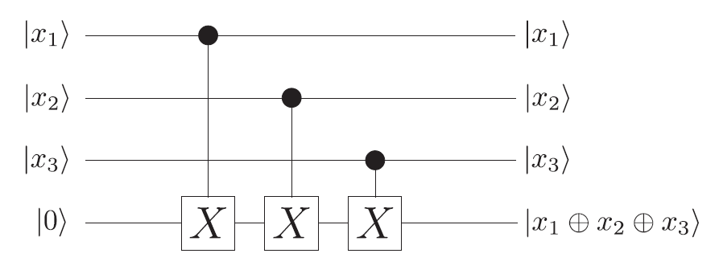
With a neat diagram show the quantum circuit computing the parity of three qubits

Slide 20
References:
www.wikepedia.org
Nielsen, Michael A., and Isaac Chuang. "Quantum computation and quantum information." (2002): 558-559.
Dawson, Christopher M., and Michael A. Nielsen. "The solovay-kitaev algorithm." arXiv preprint quant-ph/0505030 (2005).
Al-Ta'ani, Ola. Quantum circuit synthesis using Solovay-Kitaev algorithm and optimization techniques. Kansas State University, 2015.

Slide 21
THANK YOU

